Slide 1
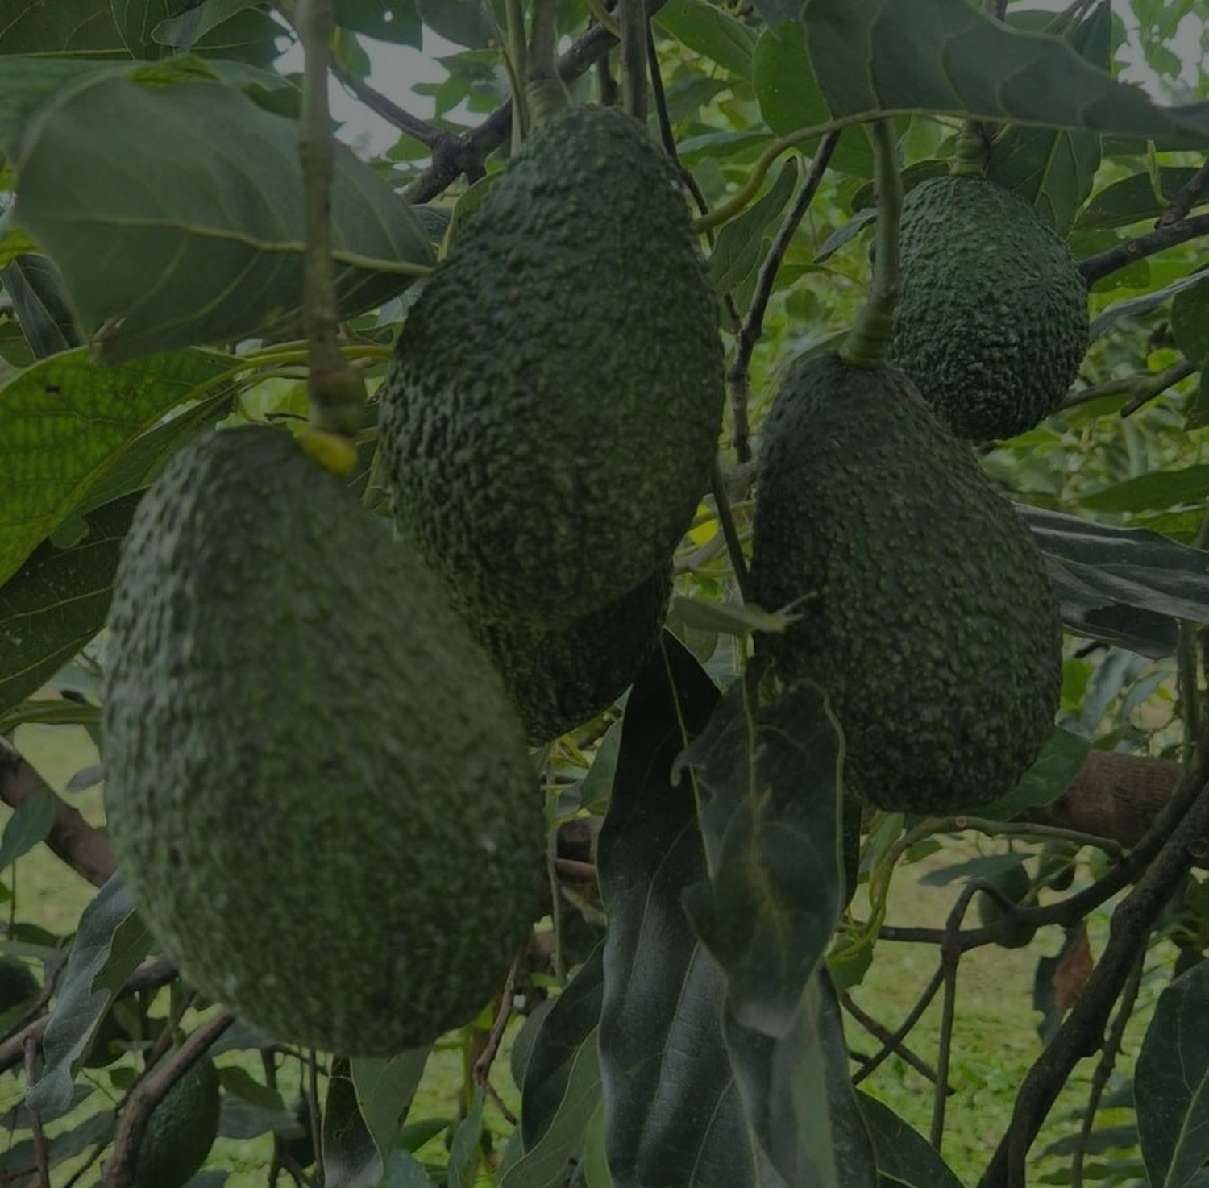

AVOCADO
GLOBAL EXPORT
COMPANY PRESENTATION
Mexican fresh produce.
Clear global execution.
Wholesale sourcing, packing coordination and logistics alignment for commercial buyers.
Hass Avocado
Papaya
Coconut
avocadoglobalexport.com
AVOCADO GLOBAL EXPORT
01

Slide 2
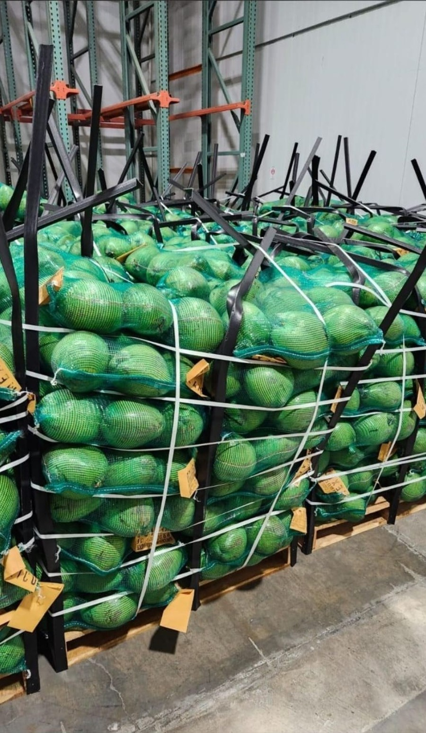
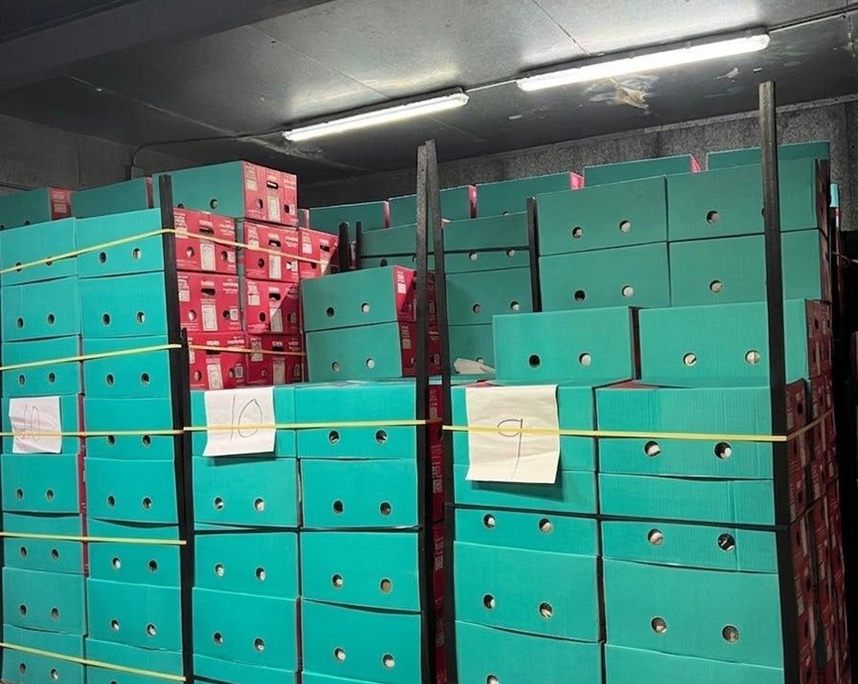
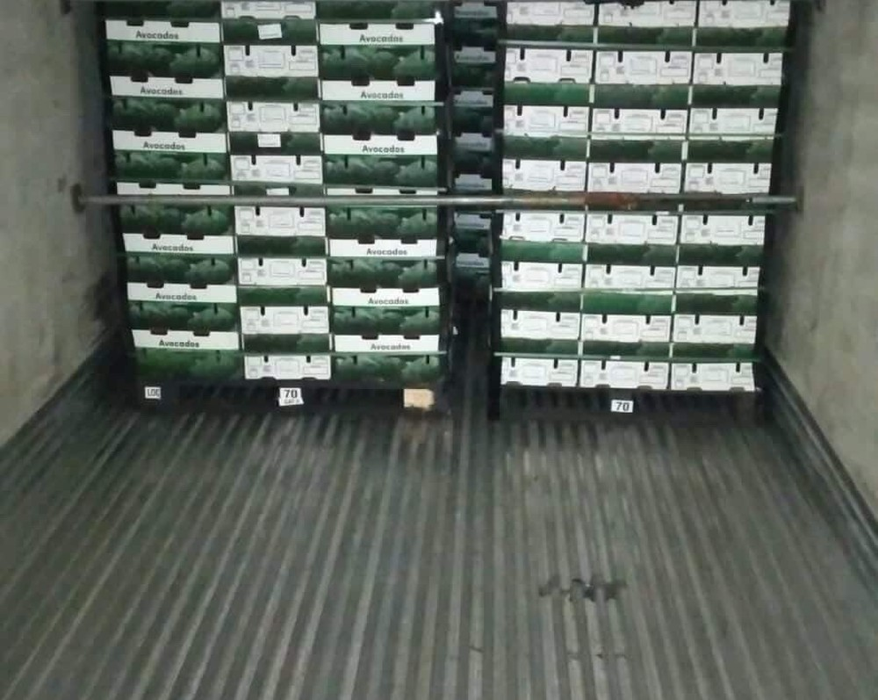
What Avocado Global Export does
QUÉ HACEMOS
AGX connects buyers with fresh produce opportunities from Mexico, aligning product specifications, packing options, destination requirements and logistics planning before each quote is confirmed.
01
Commercial sourcing
Availability, specifications and presentation are validated around buyer needs.
02
Packing coordination
Packing format, sizing and market requirements are reviewed per opportunity.
03
Logistics alignment
Ground, ocean or air alternatives are evaluated according to destination.
AVOCADO GLOBAL EXPORT
02

Slide 3
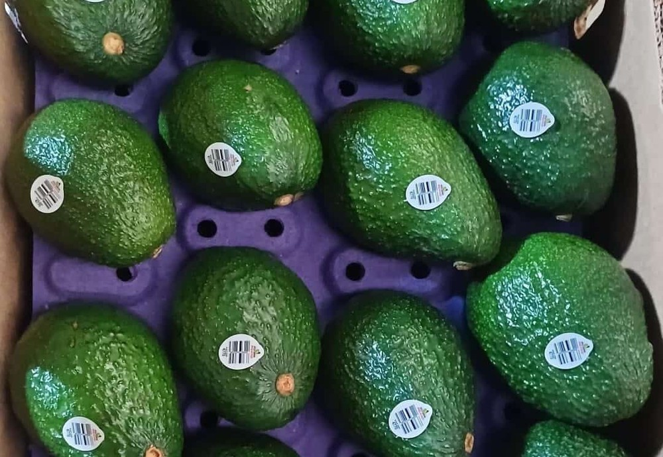
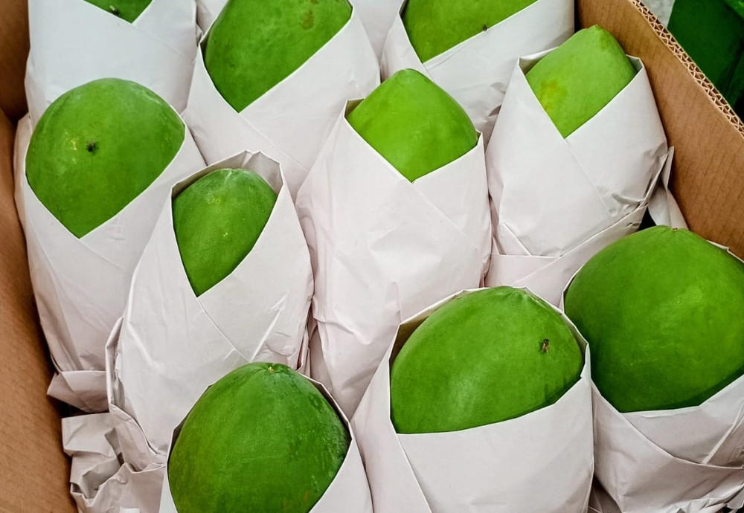
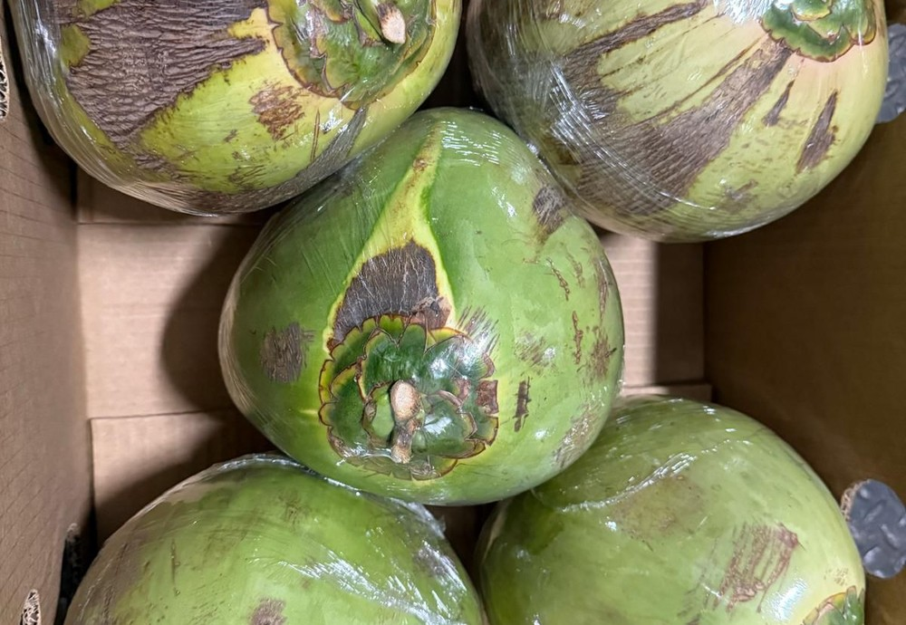
Fresh product portfolio
PORTAFOLIO COMERCIAL
Core product
Tropical line
Tropical line
Hass Avocado
Papaya
Coconut
Caliber, packing and market specifications confirmed per buyer.
Green and orange papaya options subject to availability and quality.
Wholesale supply quoted by presentation, volume and destination.
No public price list: commercial terms are quoted based on season, volume, presentation, destination and operational validation.
AVOCADO GLOBAL EXPORT
03

Slide 4
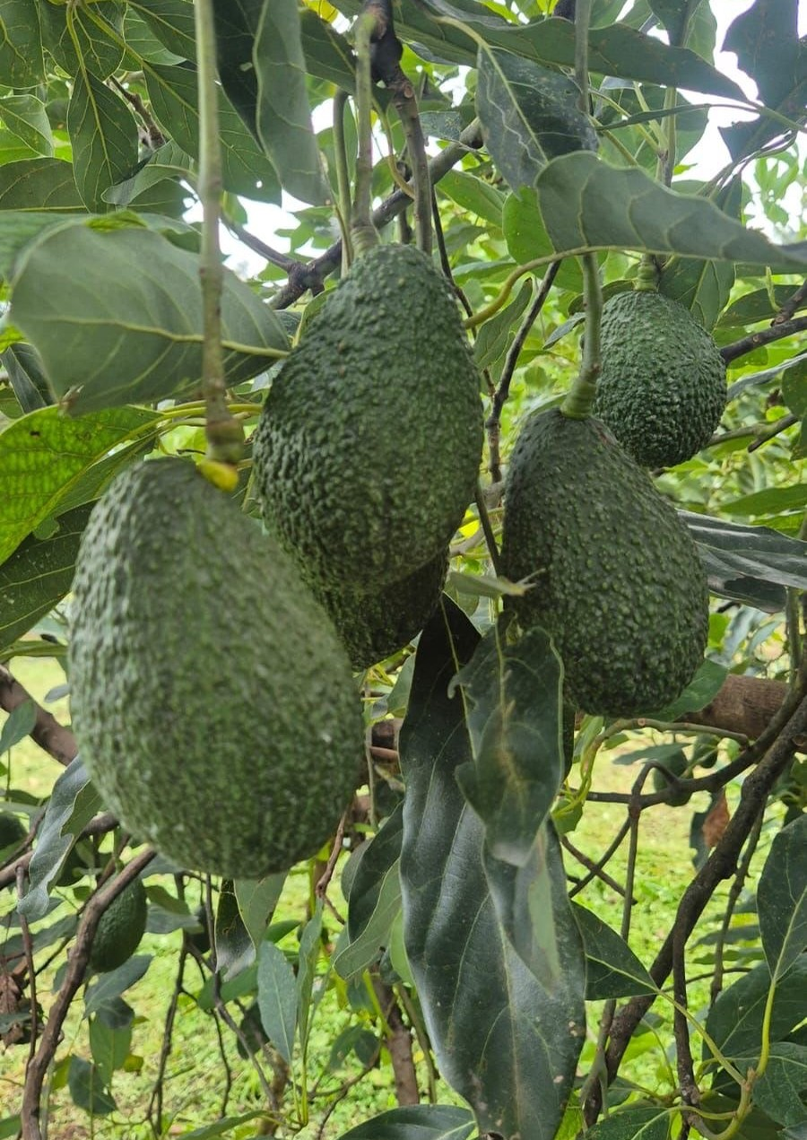
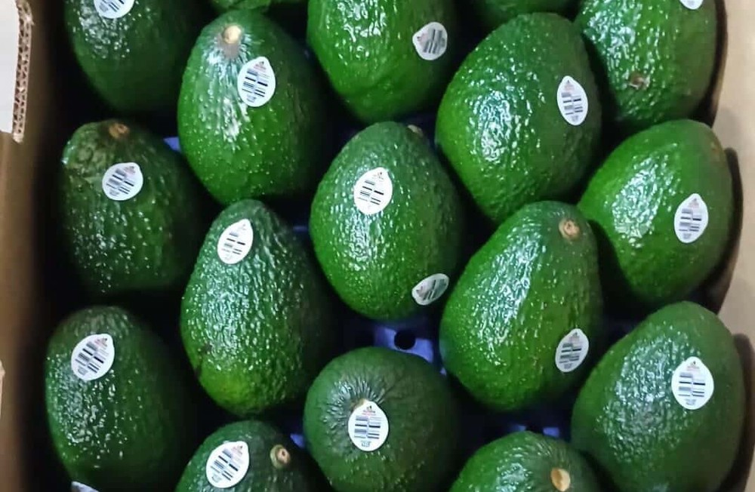
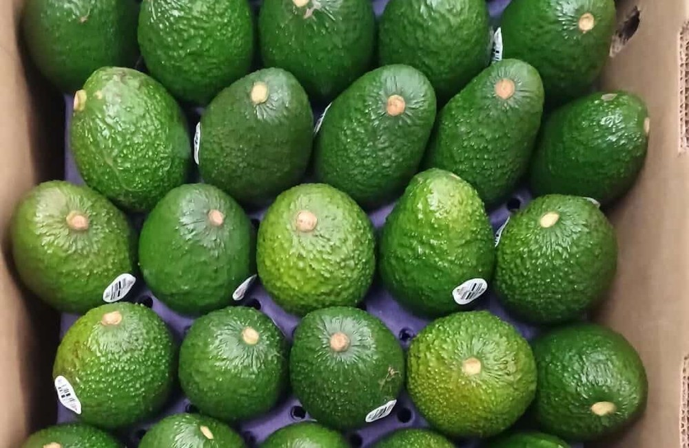
Hass avocado
PRODUCT FOCUS
Built for commercial buyers requiring consistent communication, export-oriented presentation and clear buying parameters.
✓
Caliber-based selection
Sizing and specs are defined per market and buyer requirement.
✓
Packing options
Commercial presentation, box configuration and labeling are reviewed before quote confirmation.
✓
Cold-chain planning
Refrigerated handling and transport options are aligned by route and destination.
AVOCADO GLOBAL EXPORT
04

Slide 5
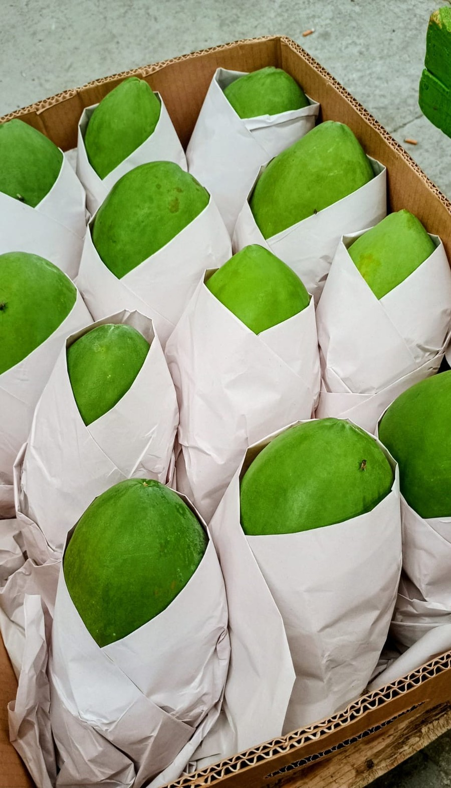
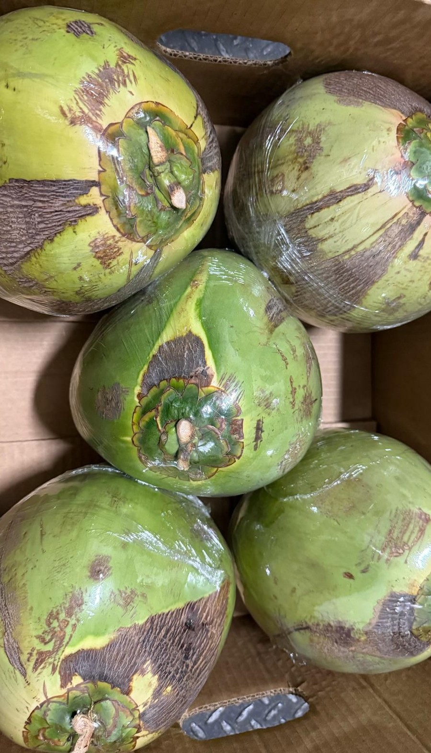
Papaya & coconut lines
TROPICAL PRODUCT OPTIONS
Papaya
Coconut
Green and orange options quoted subject to seasonal availability, requested maturity, packing presentation and destination.
Wholesale coconut supply is structured around presentation, quantity, delivery point, season and the buyer’s commercial requirements.
Green
Orange
Programs
Bulk
Palletized
Destination
Buyer inputs: variety preference, maturity, volume, frequency, destination.
Buyer inputs: presentation, count/weight, pallets, delivery city, program scope.
AVOCADO GLOBAL EXPORT
05

Slide 6
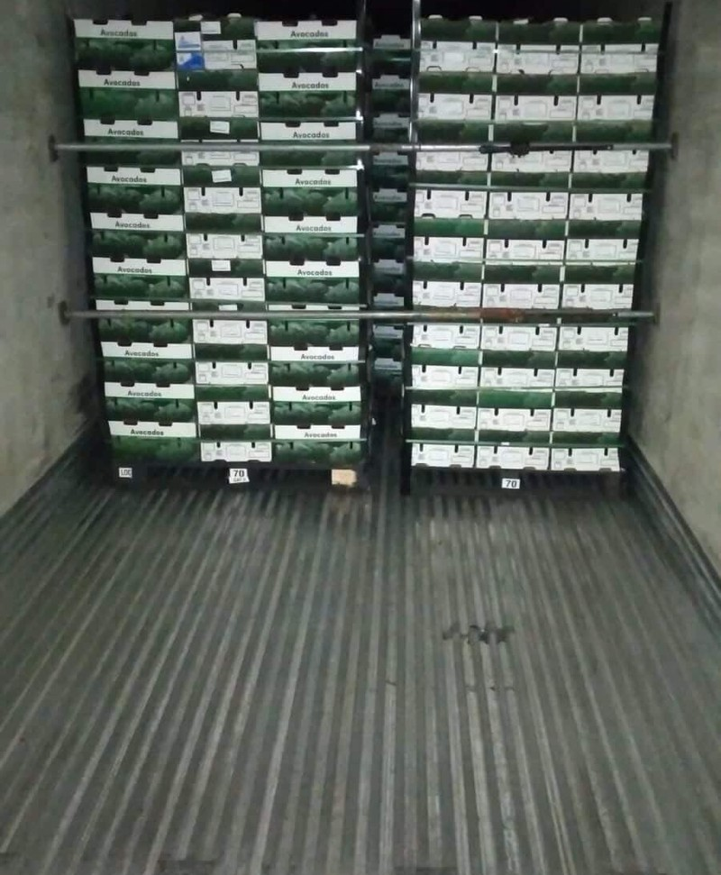
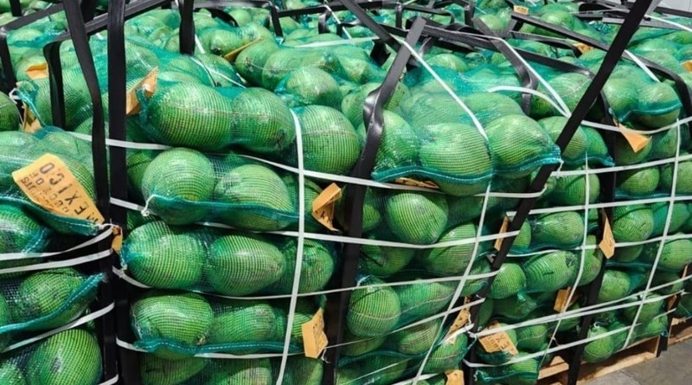
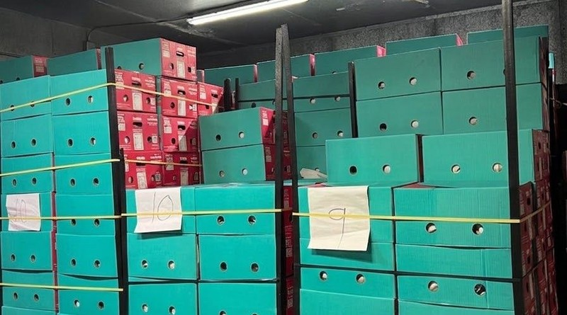
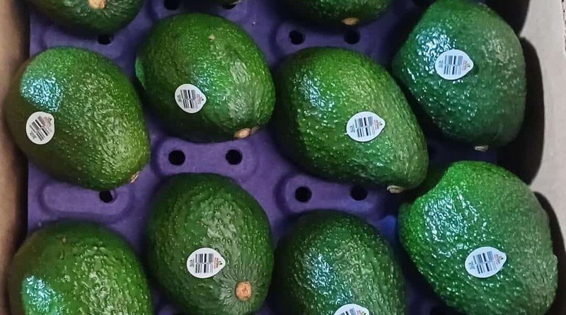
Operating model
FROM REQUEST TO SHIPMENT FOLLOW-UP
Every quote starts with the buyer’s operational requirement. AGX avoids assuming volume, specifications, delivery terms or compliance conditions before validation.
01
02
03
04
Requirement
Sourcing & packing
Logistics
Follow-up
Product, volume, size, frequency, destination and commercial terms.
Availability, packing format and specifications are reviewed.
Transport alternatives are aligned by route, timing and destination.
Communication remains active during process and recurring programs.
AVOCADO GLOBAL EXPORT
06

Slide 7
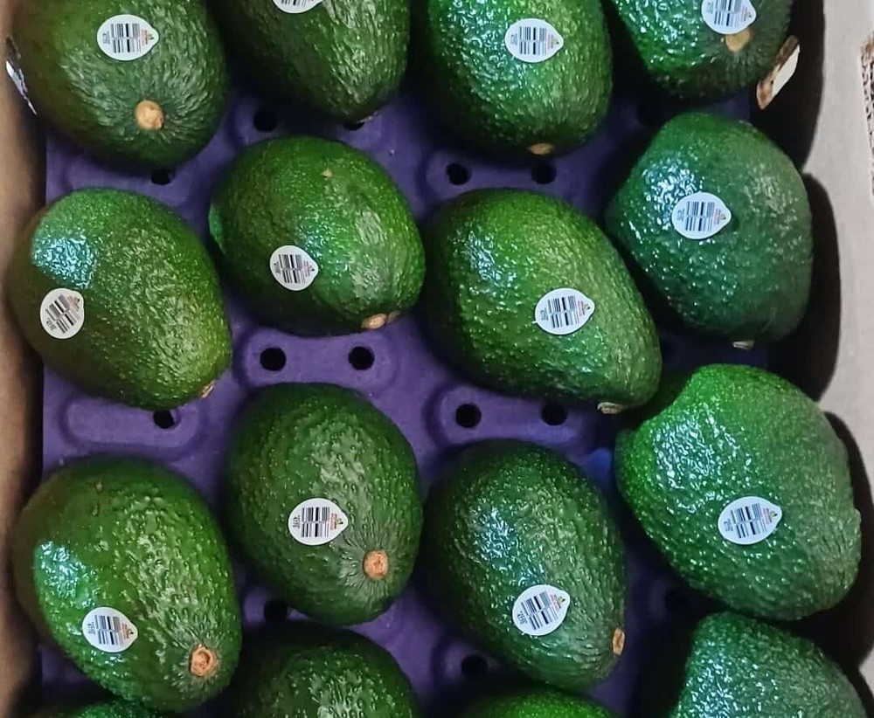
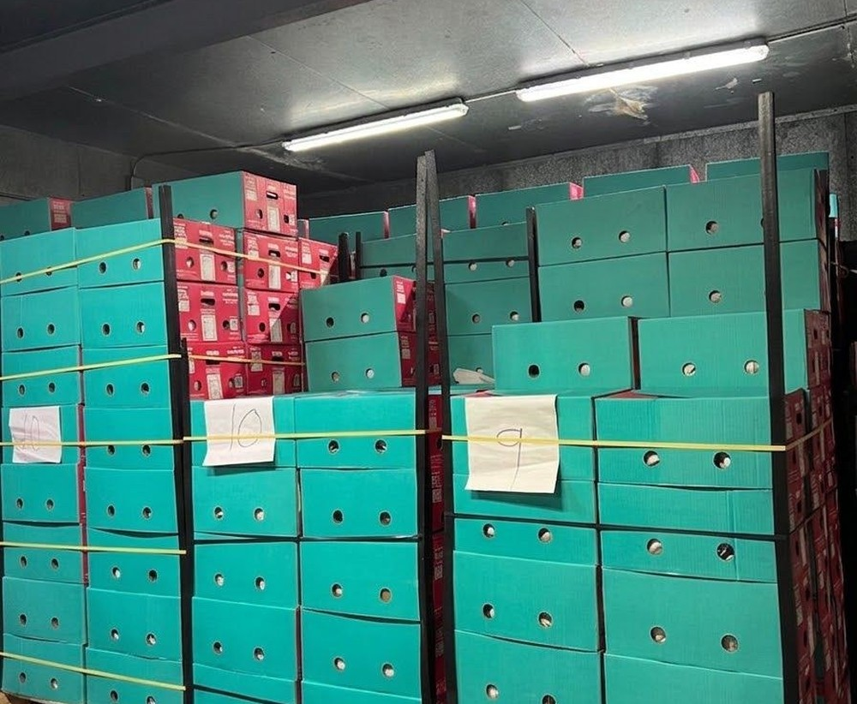
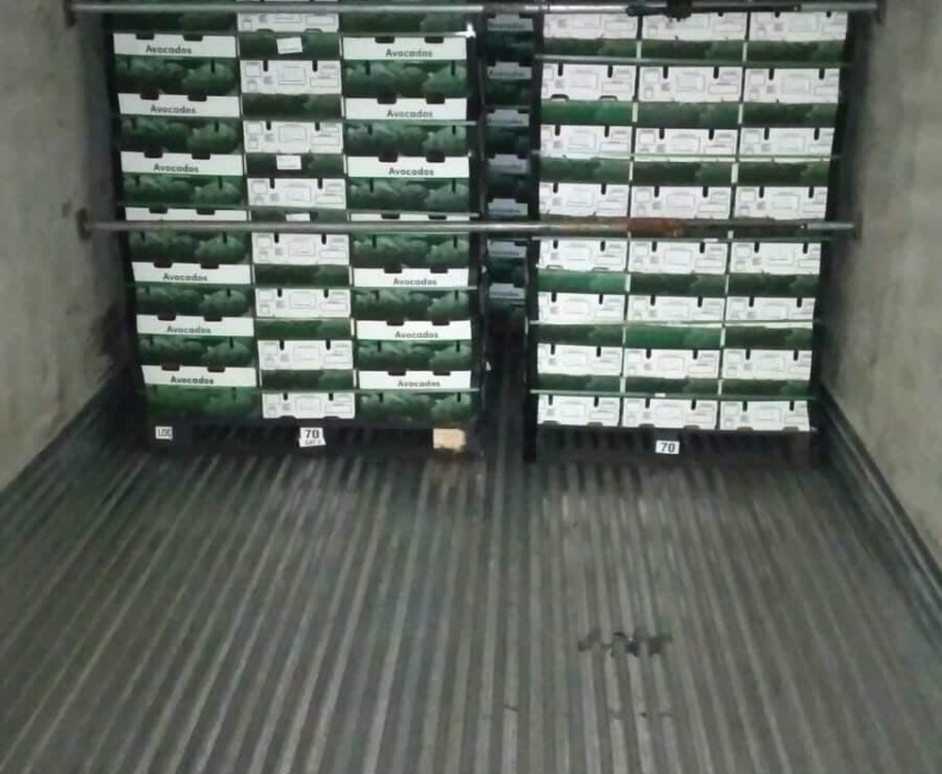
Packing, cold chain & loading
OPERATIONAL VISIBILITY
Commercial packing
Cold room handling
Refrigerated loading
Presentation, internal protection and box configuration are reviewed for each buyer.
Controlled storage helps preserve quality before dispatch when required.
Shipment preparation focused on temperature continuity and logistics timing.
Note: certifications, documentation, phytosanitary requirements and labeling depend on product and destination market. They are validated before confirming an operation.
AVOCADO GLOBAL EXPORT
07

Slide 8

Markets & buyer inputs
FOR BUYERS
The same product can require different documentation, transit time, packing format and commercial terms depending on destination.
To prepare a quote
North America
Caribbean
Europe
✓
Company name
✓
Product of interest
Asia
Middle East
✓
Volume / pallets / containers
✓
Size or specification
✓
Frequency
✓
Final destination
Product sheets available for Hass Avocado, Papaya and Coconut.
AVOCADO GLOBAL EXPORT
08

Slide 9
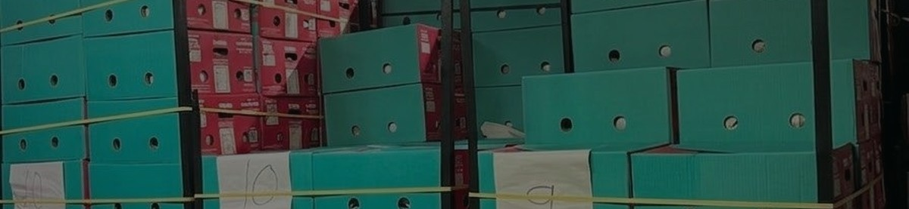
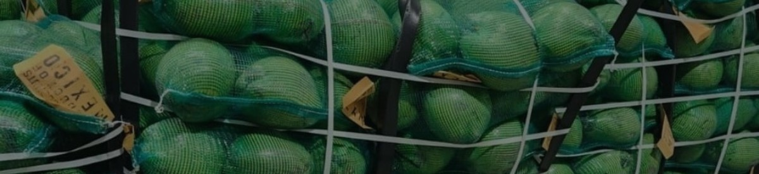
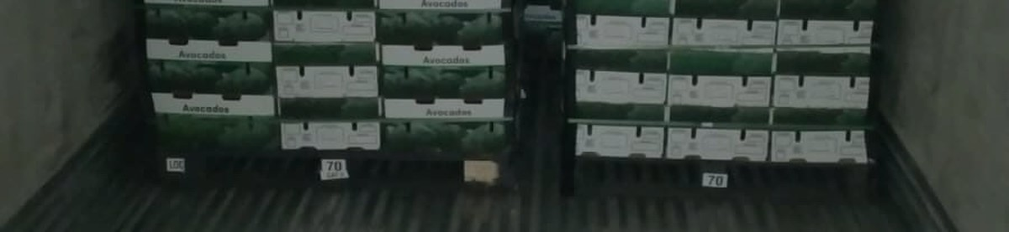
Leadership & operating roles
TRUST AND ACCOUNTABILITY
AGX presents clear points of responsibility for commercial development and Mexico-side operating coordination.
Paulo Franco
Francisco “Franky” García
Founder & CEO
Mexico Operations
Commercial Strategy · International Sales · Business Development
Product Sourcing · Packing Coordination · Logistics
@paulofrancoa_
Product and packing-side coordination
AVOCADO GLOBAL EXPORT
09

Slide 10
Ready to structure a quote?
Send the commercial requirement and AGX will review product, presentation, destination and logistics feasibility.
Contact
Next step
avocadoglobalexport.com
Submit product, volume, specification, frequency and destination. AGX will validate availability, packing and logistics before confirming terms.
avocadoglobalexport@gmail.com
+1 (815) 262-7798
@globalavocadoexport · TikTok @avocadoglobalexport
Quotes are subject to availability, specifications, destination and operational validation.
AVOCADO GLOBAL EXPORT
10

